Slide 1
CAR SALES
COMPREHENSIVE CAR SALES DATA ANALYSIS AND VISUALIZATION
Presented By:
Priyanshu Rout
Ipsita Behera
Shibani Subhadarsini
Suchismita Barik
Sambit Mahalik
Samikshya Satpathy

Slide 2
INTRODUCTION
The automobile resale market is growing rapidly. However, determining a fair resale price for a used car is a complex task involving multiple factors such as brand, model, manufacturing year, kilometers driven, fuel type, transmission, etc. This project aims to develop a machine learning-based car selling price prediction model that helps both buyers and sellers estimate the ideal resale value of a car.

Slide 3
OBJECTIVE
The primary objective of this project is to explore, analyse, and visualize automobile sales data to identify significant trends, insights, and key performance metrics within the Indian car market. By transforming raw data into visually interactive dashboards, the aim is to facilitate informed decision-making for stakeholders including customers, dealers, market analysts, and business strategists. The analysis focuses on various attributes such as car brand, model, price, year of manufacture, fuel type, owner history, car type, and geographical location. The visualization reveals which car types and brands are popular, how ownership and fuel types affect pricing, and regional trends in car sales across India.

Slide 4

MICROSOFT_EXCEL
Microsoft Excel is a spreadsheet software developed by Microsoft. It is used for storing, organizing , analyzing and visualizing data in tabular form

Slide 5
Data Sell Model
Car Name : Brand/model of the car
Year: Year of Purchase
Present Price: Current showroom price
KMS Driven: Distance driven in Kilometers
Transmission: Manual or Automatic
Owner: Number of previous owner
Selling Price: Target column
Seller Type: Dealer or Individual

Slide 7

POWER BI
Power BI is a business analytics and data visualization tool developed by Microsoft. It enables users to connect to various data sources, clean and transform data, create interactive dashboards and reports, and derive meaningful insights.

Slide 8
Workflow of Power Bi
Import Data → From Excel, SQL, Web, etc.
Transform Data → Using Power Query (clean, merge, shape).
Model Data → Create relationships, DAX formulas.
Visualize Data → Charts, cards, maps, filters, slicers.
Publish & Share → On Power BI Service, with access control.

Slide 9
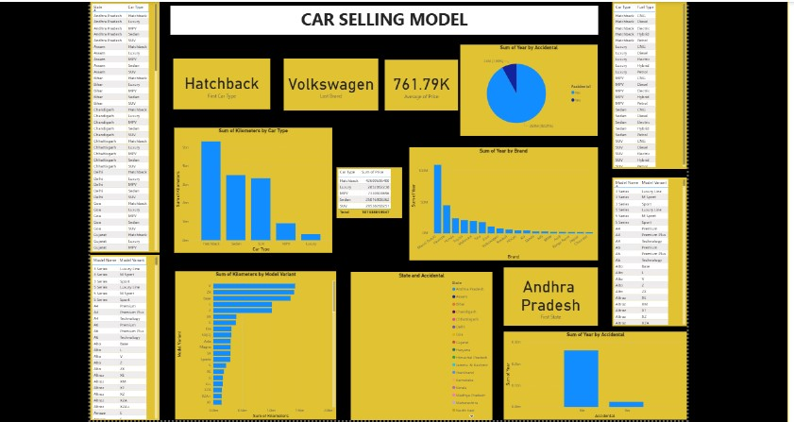

Slide 10

TABLEAU
A Tableau Dashboard is a visual display of key metrics and data insights combined in a single screen. It enables users to make data-driven decisions by presenting interactive charts, KPIs, maps, and filters in a visually intuitive format.

Slide 11
Benefits Of Using Tableau
Real-time interactivity and dynamic updates
Easy integration with Excel, SQL, and cloud data sources
User-friendly interface with drag-and-drop design
Supports advanced calculations via Tableau Calculated Fields

Slide 12
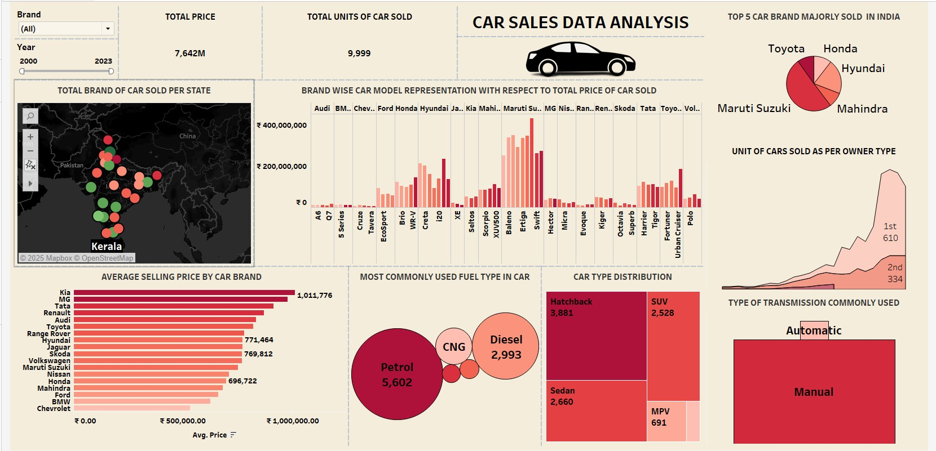

Slide 13
MACHINE LEARNING
Machine Learning (ML) is a subfield of Artificial Intelligence (AI) that focuses on building systems that can learn from data, identify patterns, and make decisions without being explicitly programmed.
Arthur Samuel (1901–1990) known as the ‘’Father of Machine Learning’’. Coined the term “machine learning” in 1959.

Slide 14
Conclusion
The Car Selling Price Prediction Model developed in this project demonstrates the practical application of data analysis and machine learning techniques in solving real-world business problems. By analyzing historical data of used cars, we were able to identify key features such as present price, kilometers driven, fuel type, transmission, number of previous owners, and year of manufacture, which significantly impact the resale value of a car.
The preprocessing steps, including data cleaning, feature engineering, and encoding categorical variables, were crucial in preparing the data for model training. After experimenting with various regression algorithms—Linear Regression, Decision Tree Regressor, and Random Forest Regressor—we found that the Random Forest model provided the highest accuracy and robustness in predicting car selling prices. Its ability to handle non-linear relationships and complex feature interactions made it the best fit for this dataset

